Slide 1
July 2016 Meetup
WordPress Singapore

Slide 2


Made possible by

Slide 3
Topics Today
Moving Beyond WordPress in Tech in Asia: Back-End Engineering
Lester Chan
Moving Beyond WordPress in Tech in Asia: Front-End Engineering
Lester Chan
Community Open Space
Everyone

Slide 4
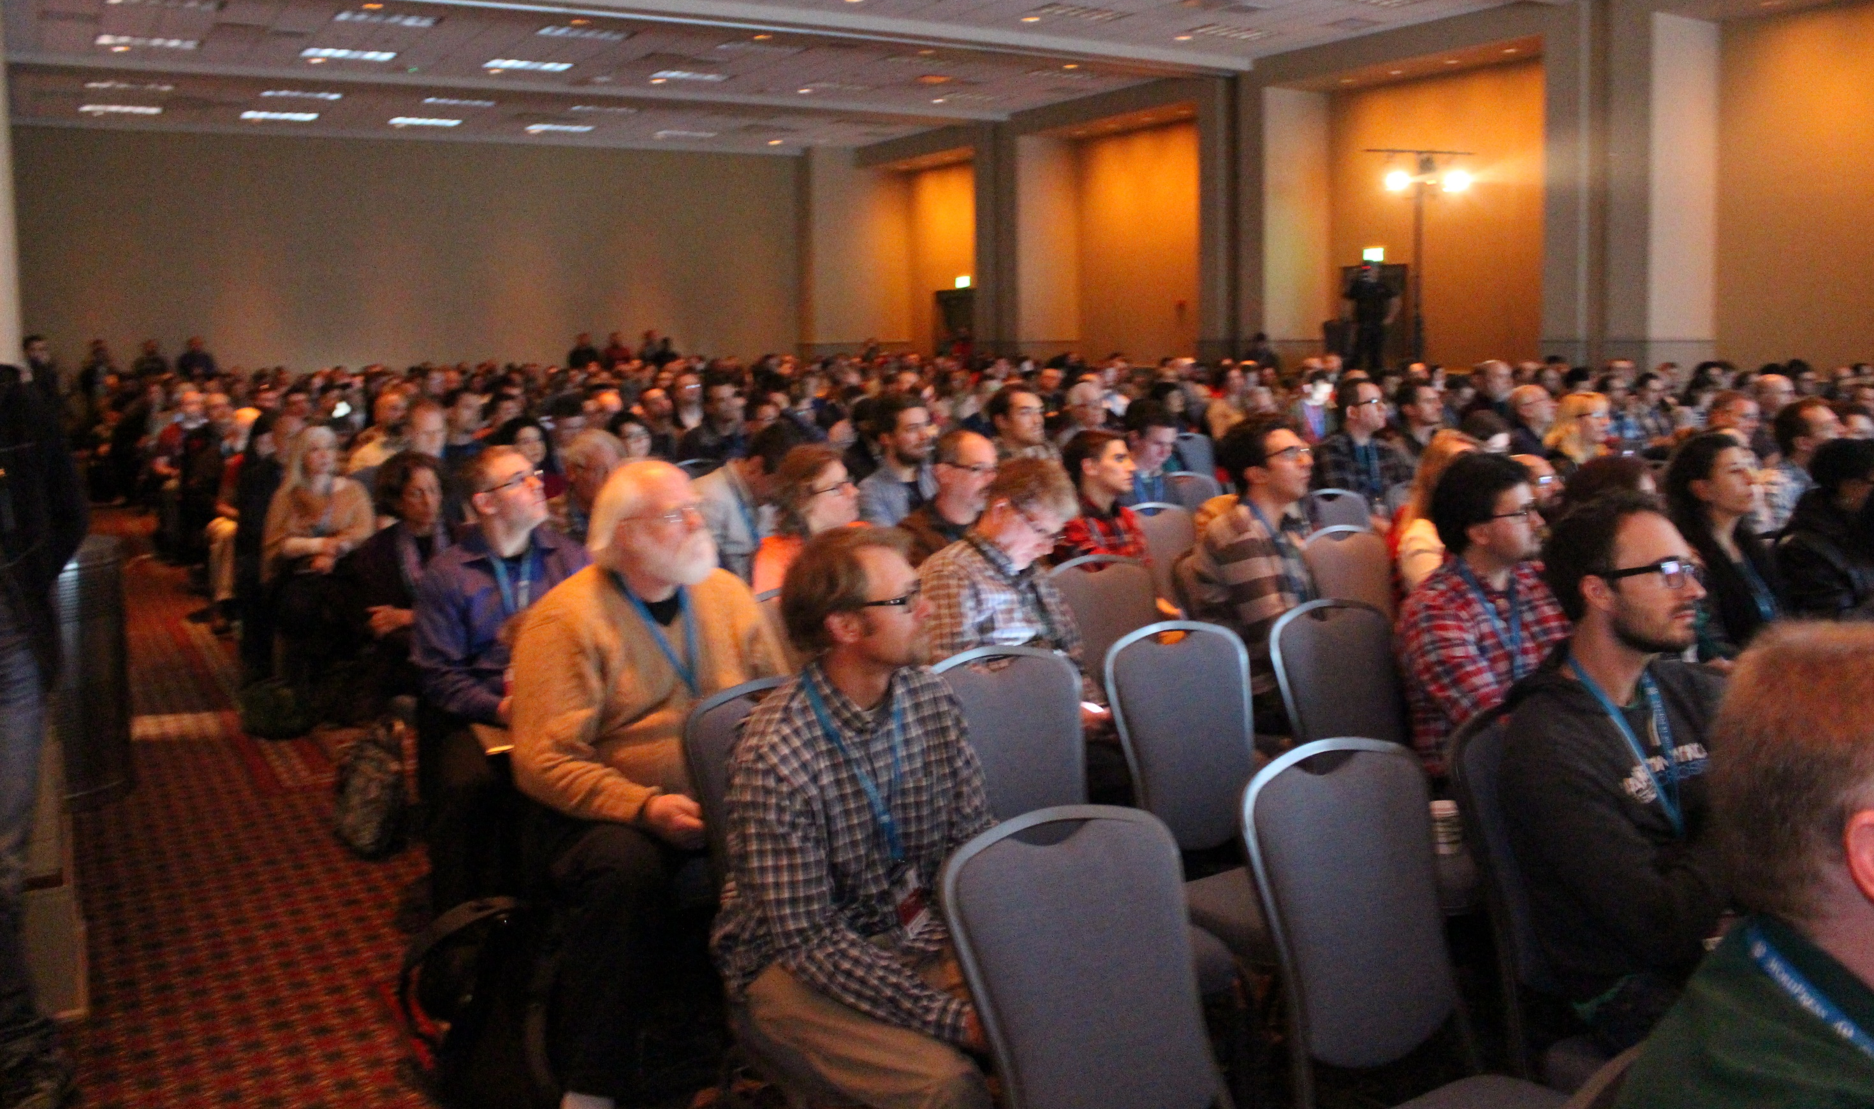
WordCamp Singapore 2016 6 September

Slide 5
2 Tracks
Developer & Business
Developers will benefit from WordPress developers, plugin & theme creators world-wide.Expect to hear WordPress best practices, how to secure WordPress sites.
You will also gain some insight from WordPress business owners who who have been working with the eco-system to create business value.
Lastly, expect famous international plugin authors to talk about their experiences with contributing to the WordPress project.
User & Education
If you have wondered what you could do to get the best milage from using WordPress, this track would get you there.
Learn from bloggers, site maintainers and even professors on how they best used WordPress to manage their content without coding knowledge.
General web design and hosting best practices will also be available in this track

Slide 6
Ticket Sales are Open Early Bird Tickets still available but running out

Slide 7
https://singapore.wordcamp.org/

Slide 8
We really want members to speak or host meetups

Slide 9
You do not have to be a certified expert to speak on a topic that you are passionate about (WordPress related of course)

Slide 10
Join http://www.meetup.com/WordPress-Singapore

Slide 11
Closing
Our Next Meetup will likely be on the 20 July
We would love to have some JavaScript experts giving a talk
We are also looking for speakers to give talks on other subjects such as
Development
Design
Content Creation
SEO
Social Media
And more ☺

